Slide 1
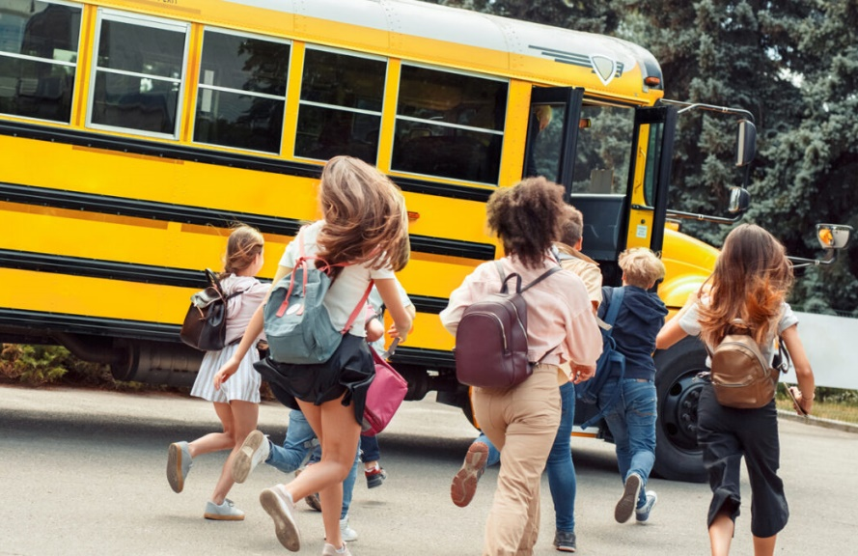
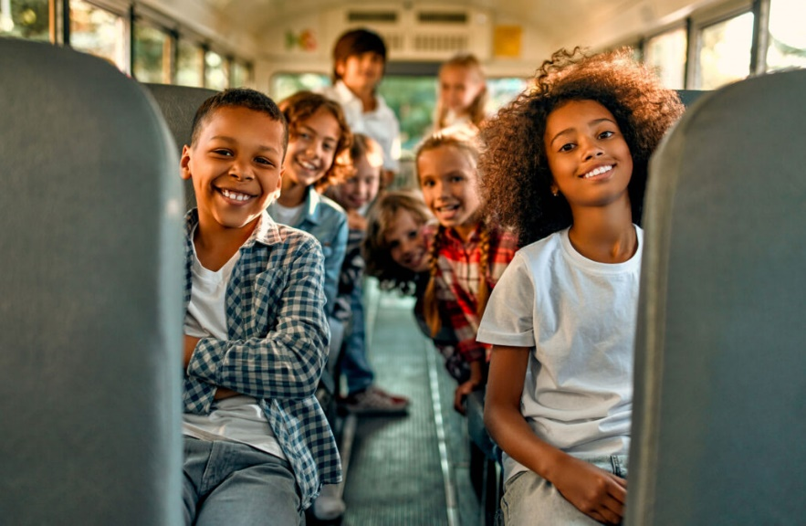
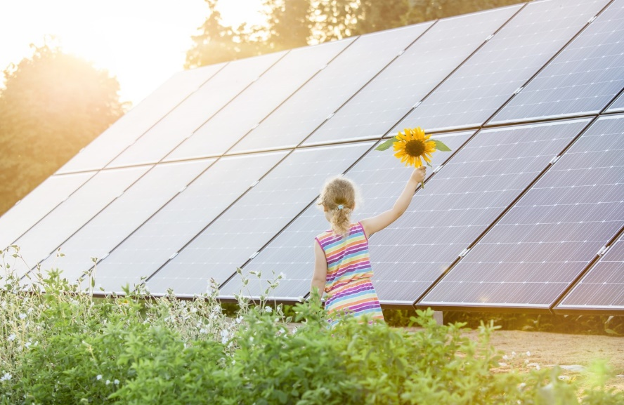
FUNDING FOR CLEAN SCHOOL BUSES
CLEAN SCHOOL BUS PROGRAM - BIPARTISAN INFRASTRUCTURE LAW
Francisco Sayu
Emerging Technology Director

Slide 2
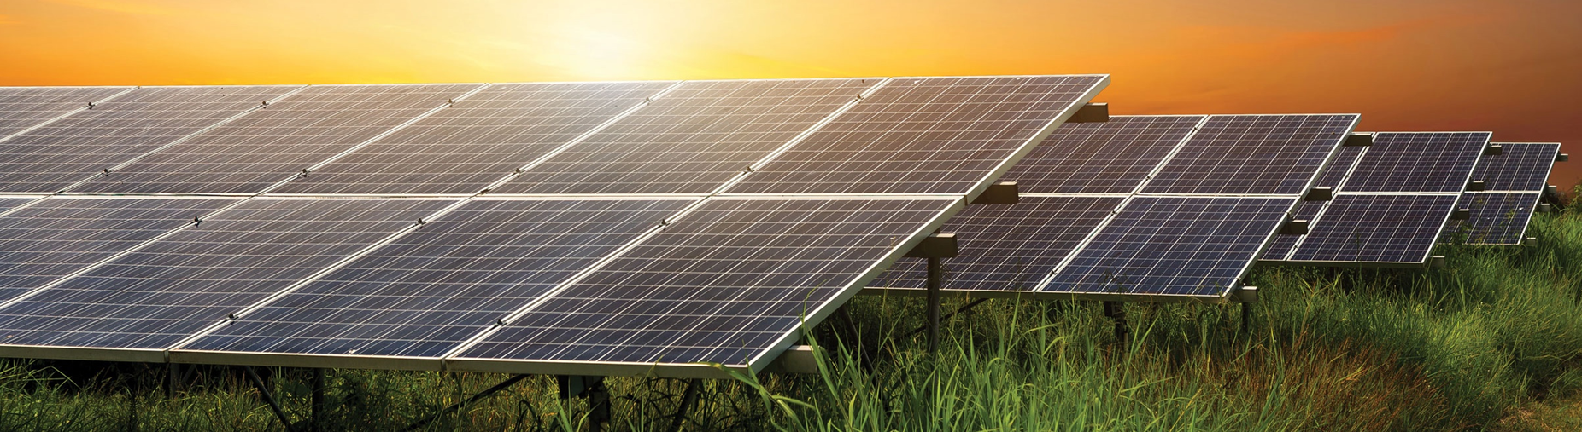
RENEW Wisconsin is a nonprofit organization dedicated to building a stronger, healthier, more vibrant Wisconsin through the advancement of renewable energy. We work on policies and programs that support solar power, wind power, biogas, local hydropower, geothermal energy, and electric vehicles.

Slide 3
WHY SCHOOL BUSES?
School buses travel over 3 billion miles annually, providing transportation for more than 25 million children daily. Most school buses run on diesel fuel
Diesel buses create tailpipe pollution, which causes a wide range of health issues
Children are more vulnerable to diesel pollution than adults
The air inside a school bus can be more polluted than the air outside of it
One solution: Electric buses!
Can cut diesel emissions in communities burdened by air pollution and high rates of childhood asthma
Electric buses cost 60% less to operate and maintain

Slide 4
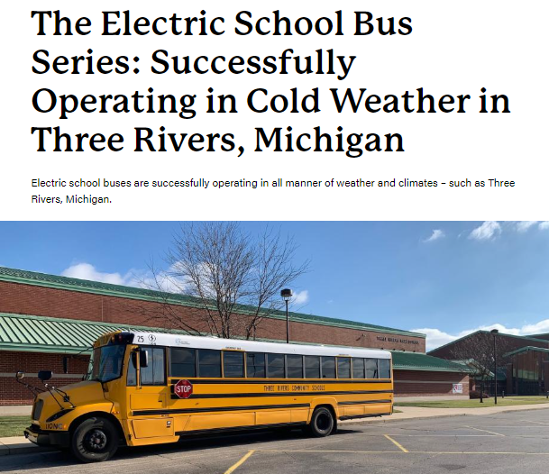
IMPORTANT CONSIDERATIONS FOR ELECTRIC SCHOOL BUSES
Upfront cost
Charging infrastructure
Range of the bus on a single charge
Fuel and maintenance savings
Operation in cold weather
Proper planning can help ensure a successful transition to electric school buses

Slide 5
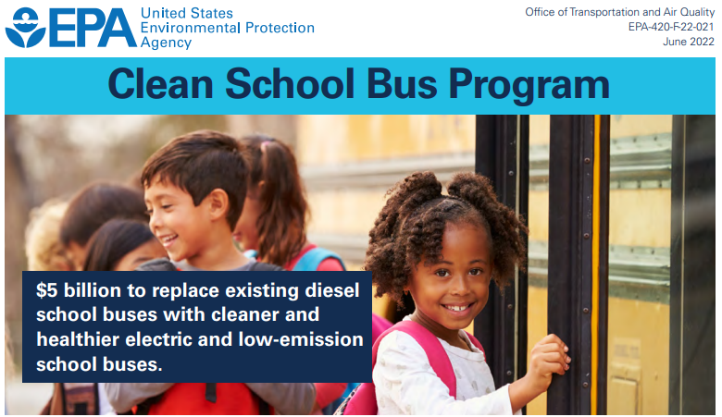
BIPARTISAN INFRASTRUCTURE LAW
CLEAN SCHOOL BUS PROGRAM
Program goals
Replace existing school buses with new clean buses that produce either zero or low tailpipe emissions compared to their older diesel predecessors
School bus upgrades funded under this program will result in cleaner air on the bus, in bus loading areas, and in the communities in which they operate

Slide 6
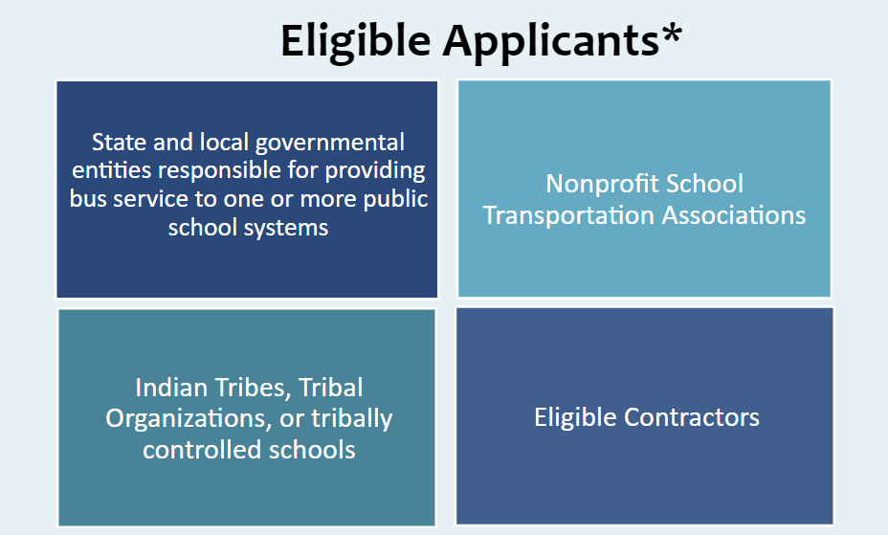
CLEAN SCHOOL BUS PROGRAM

Slide 7
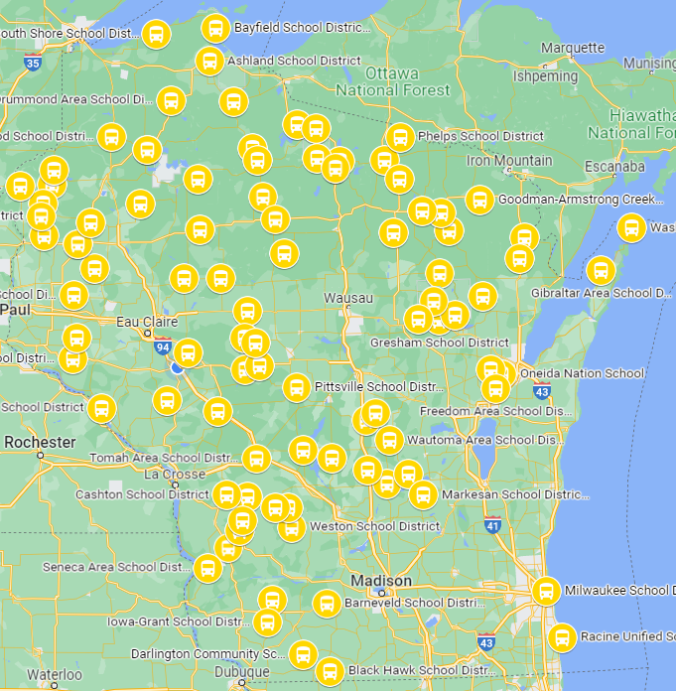
2023 CLEAN SCHOOL BUS (CSB) REBATES PROGRAM OVERVIEW
Simple online application
Lottery
Prioritize high-need, rural, and tribal school districts (94 priority school districts in WI)
Up to $345,000 per electric bus + charging station (up to 25 buses)
2nd round of the rebate program – OPEN NOW through January 31, 2024
Notes:
High-need school districts: 20% or more students living in poverty

Slide 8
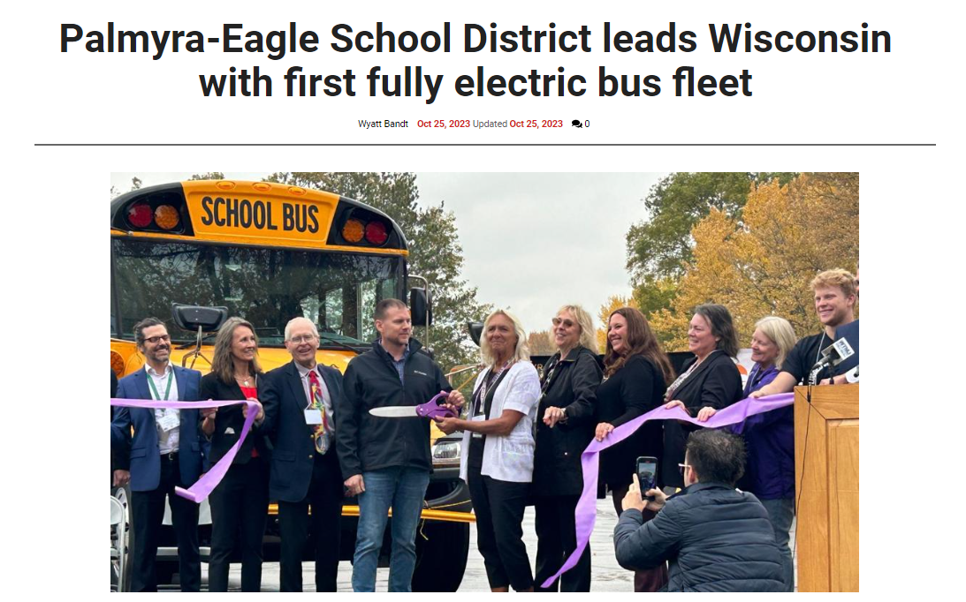
2022 CLEAN SCHOOL BUS (CSB) REBATES PROGRAM RESULTS
School District | Number of Buses
Lomira School District | 4
Random Lake School District | 1
Palmyra-Eagle Area School District | 6
Coleman School District | 2
Edgar School District | 1
Granton Area School District | 5
Lac du Flambeau #1 School District | 10
Lakeland UHS School District | 10
Minocqua J1 School District | 12
Melrose-Mindoro School District | 1
Augusta School District | 3
Mondovi School District | 5
Pepin Area School District | 1
Winter School District | 2
Wild Rose School District | 2
 | 65
Notes:
High-need school districts: 20% or more students living in poverty

Slide 9
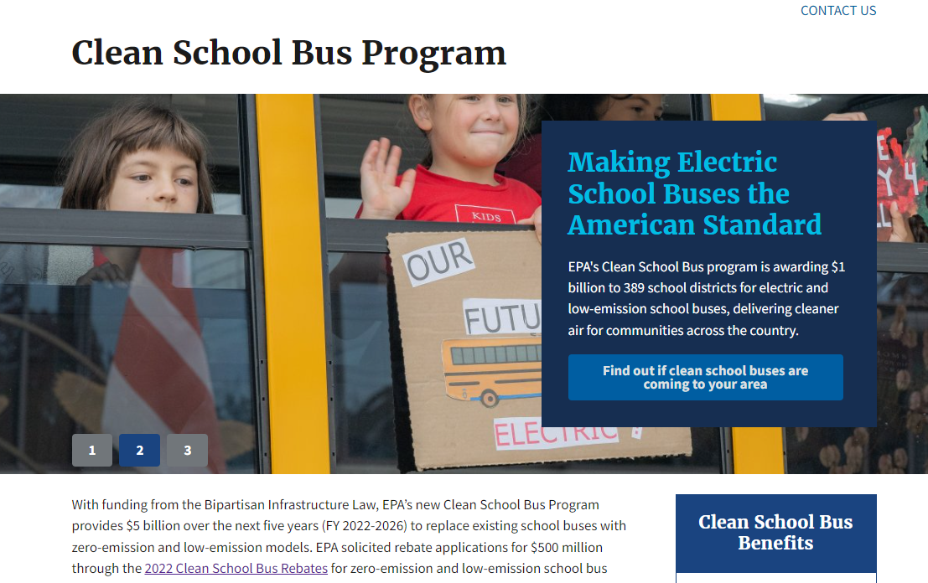
APPLYING FOR 2023 FUNDING
Verify your organization has an active registration on SAM.gov
Talk to all parties involved in the project (superintendent, transportation director, school board, utility provider)
Submit your complete application via the online application portal by January 31, 2024, at 4 PM ET
Sign up for the EPA Clean School Bus Program listserv to stay up to date
Notes:
High-need school districts: 20% or more students living in poverty

Slide 10
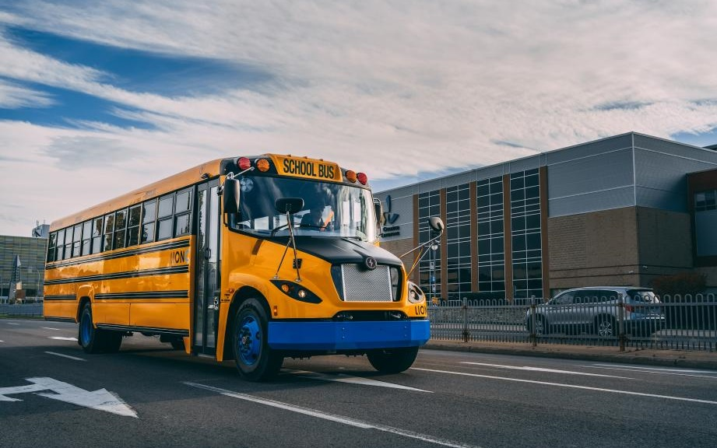
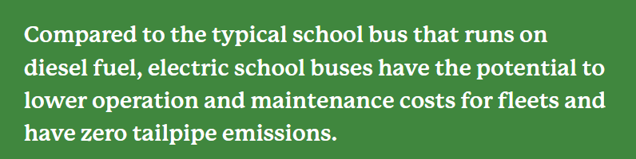
THANK YOU!
Francisco Sayu
Emerging Technology Director
RENEW Wisconsin www.renewwisconsin.org francisco@renewwisconsin.org
Image courtesy of the World Resources Institute’s Electric School Bus Initiative, https://electricschoolbusinitiative.org/about-world-resources-institutes-electric-school-bus-initiative

